Slide 1
Customer Churn Prediction Analysis Date: June 26, 2025 Prepared by: PAROMITA SAHA

Slide 2
Agenda
Project purpose
Introduction
Overall Churn Distribution
Data analysis
Model building & evaluation
Conclusion & recommendation

Slide 3
Project purpose
The primary purpose of a customer churn prediction project is to proactively identify customers who are at high risk of discontinuing their business with a company.
This allows businesses to:
Implement targeted retention strategies: intervene with at-risk customers before they churn, offering personalized incentives or solutions.
Optimize resource allocation: efficiently deploy marketing, sales, and customer support resources towards customers who need attention most.
Minimize revenue loss: reduce the financial impact of customer attrition by retaining valuable customers.
Improve products and services: understand the underlying reasons for churn to make informed decisions about product development, service enhancements, and overall customer experience.

Slide 4
Introduction to Customer Churn Prediction
What is Customer Churn?
Customer churn, or customer attrition, refers to the rate at which customers stop doing business with an entity.
It's a critical metric for businesses as retaining existing customers is often more cost-effective than acquiring new ones.
Why Predict Churn?
Proactive Retention: Identify at-risk customers early to implement targeted retention strategies.
Resource Optimization: Allocate marketing and support resources effectively.
Revenue Protection: Minimize revenue loss from departing customers.
Service Improvement: Understand reasons for churn to improve products/services.

Slide 5
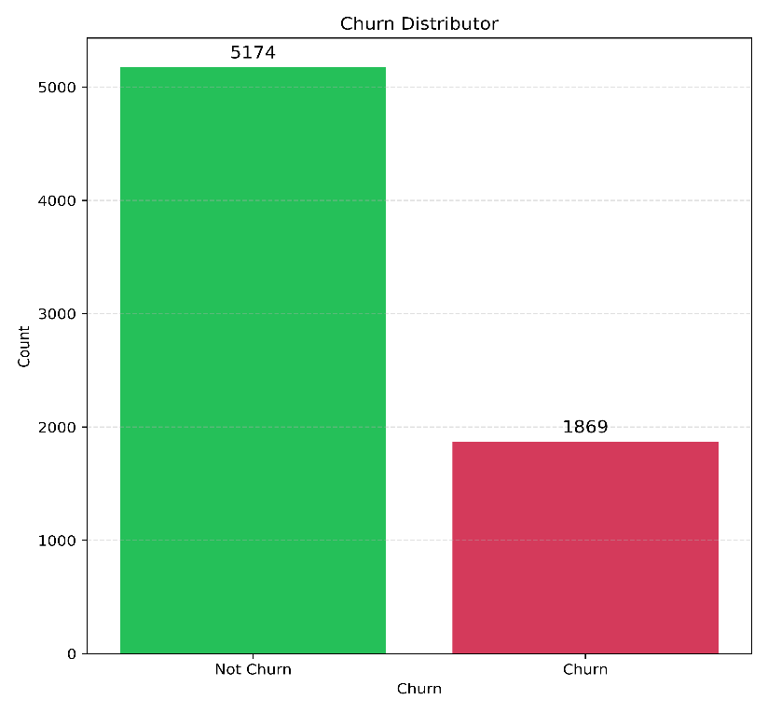
Overall Churn Distribution
Key Insight: The dataset shows an imbalance between customers who churn and those who do not.
Observations:
5174 Customers Did Not Churn.
1869 Customers Churned.
Implication:
This imbalance is important for model training. Models might be biased towards predicting "no churn" due to the larger sample size.

Slide 6
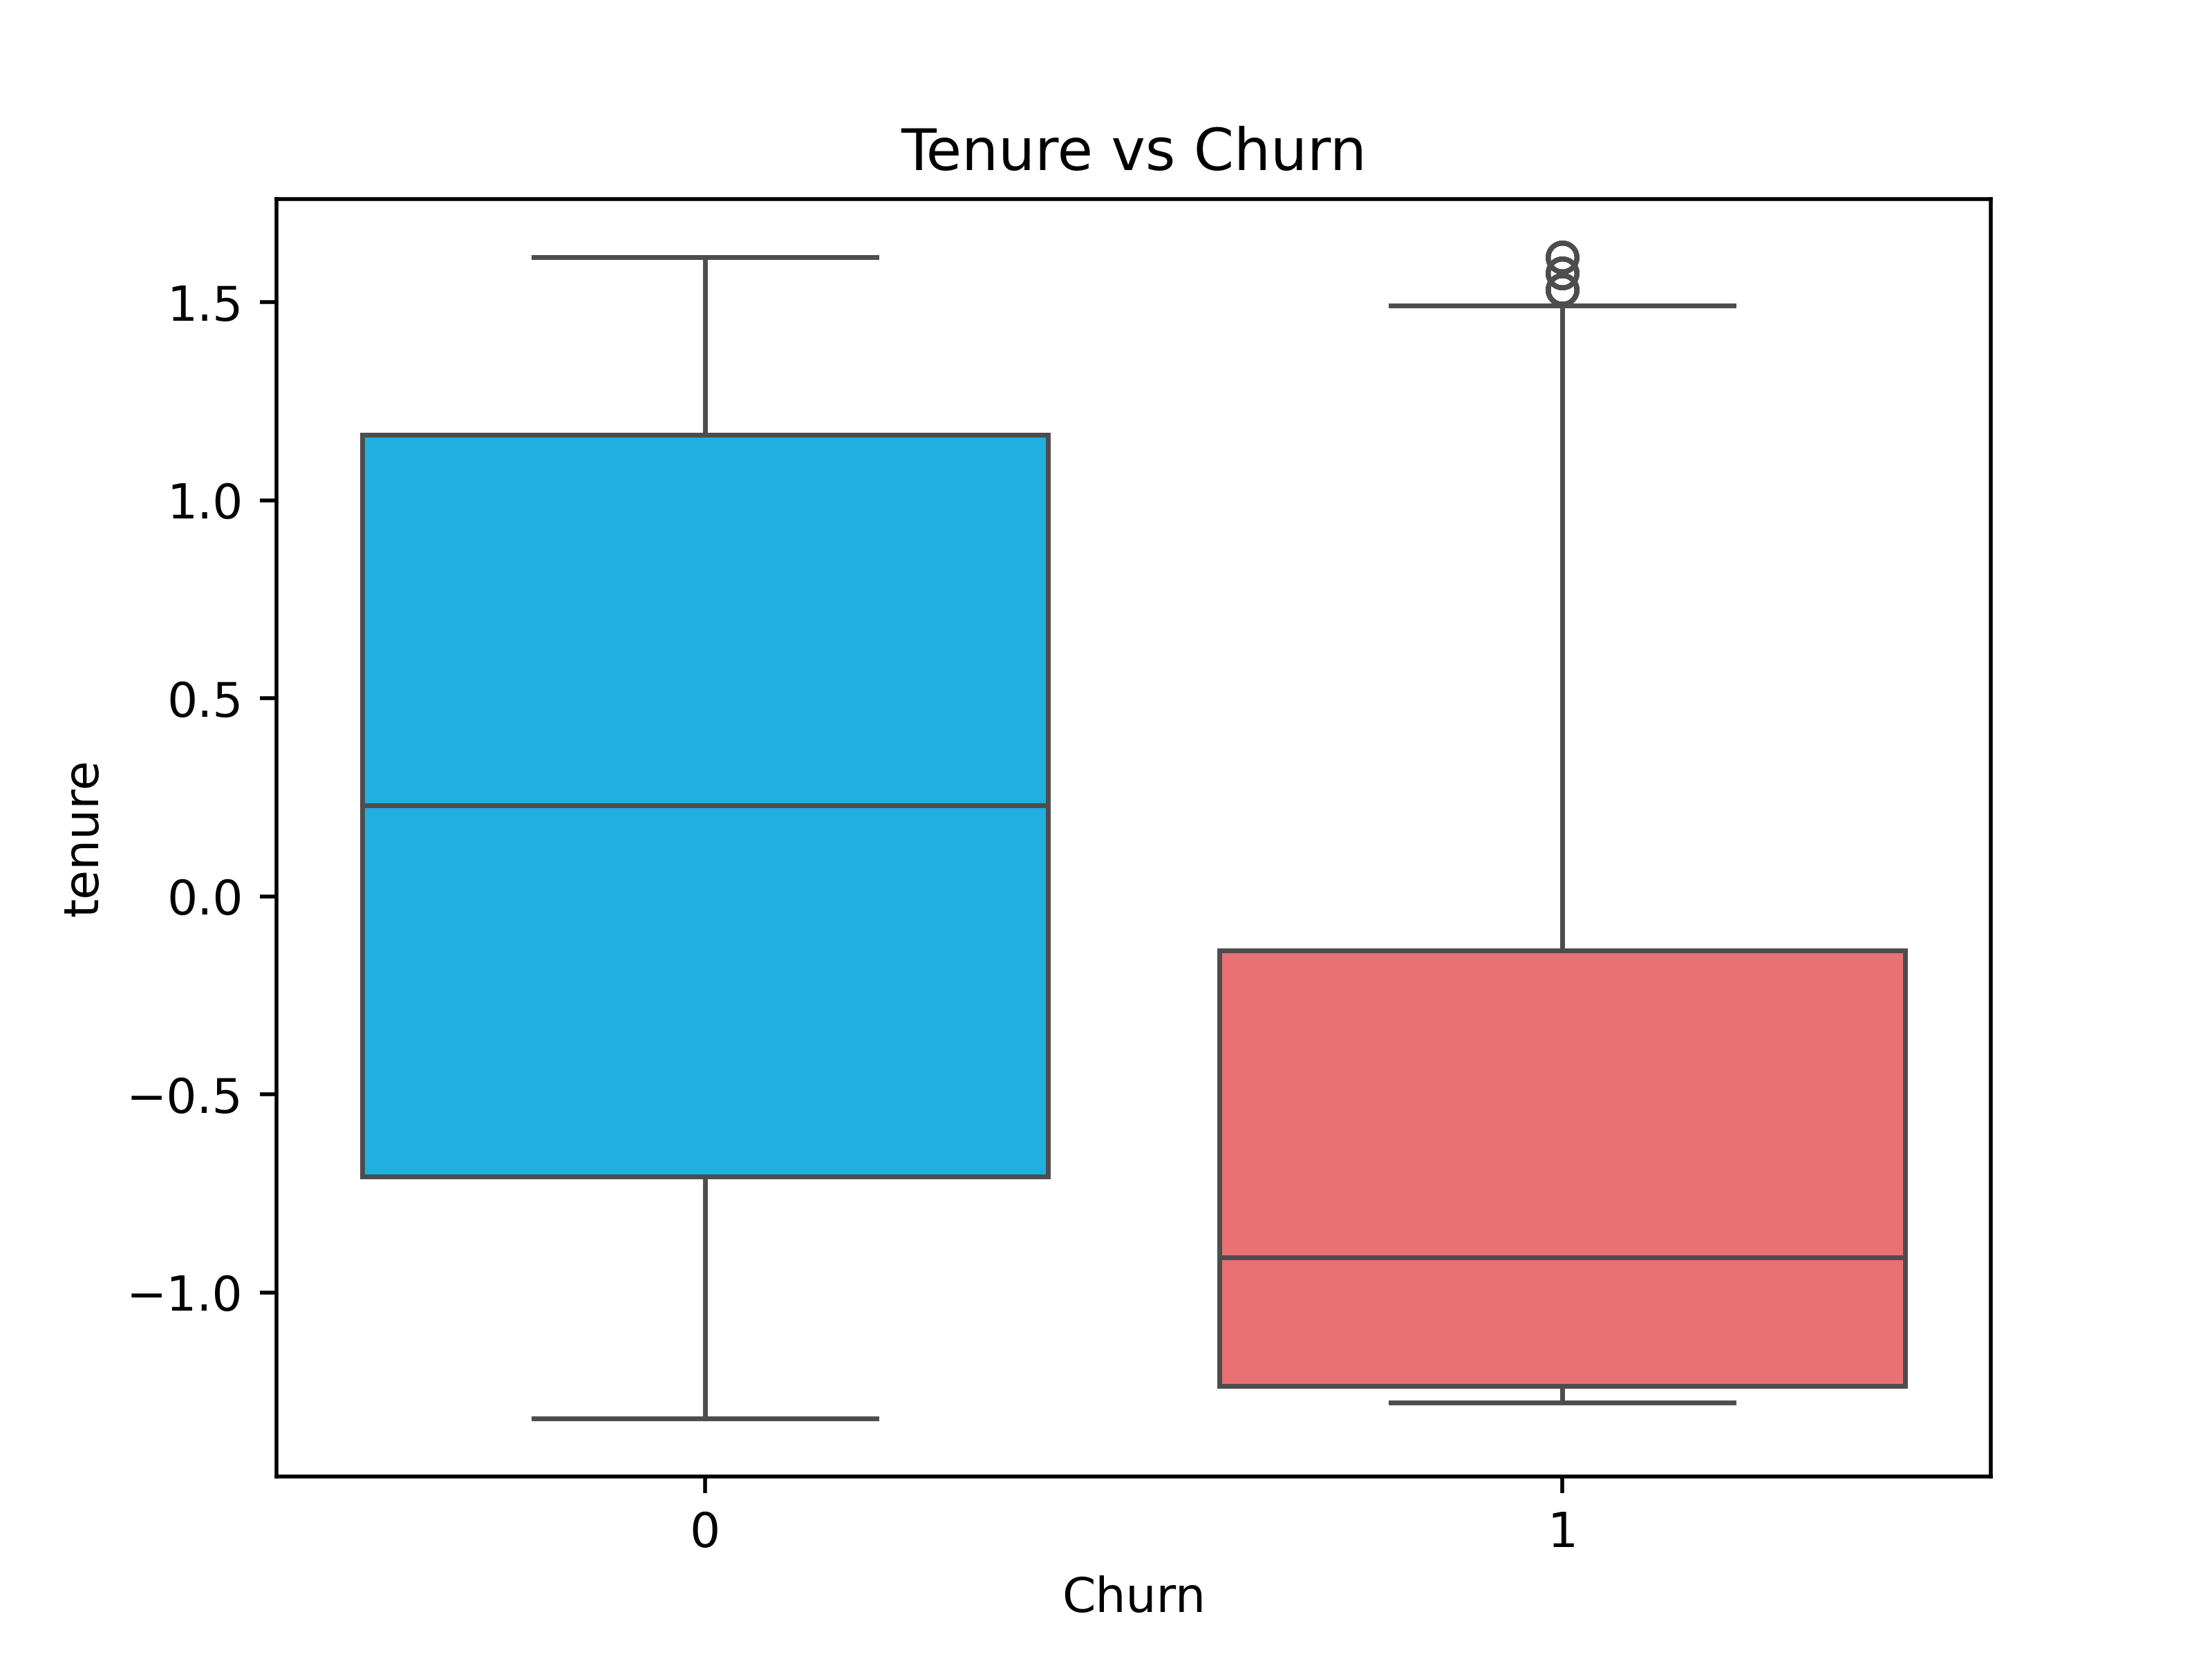
1. Tenure vs. Churn
Data analysis
Key Insight: Visual confirmation of the impact of customer tenure on churn.
Observations:
Churn (1) Group: Shows a much lower median tenure and a tighter distribution of tenure values. This indicates that customers who churn are generally newer to the service.
No Churn (0) Group: Exhibits a higher median tenure and a broader range, suggesting that long-term customers are less likely to churn.
Conclusion: Newer customers are at a higher risk of churning. Retention efforts should specifically target customers in their early stages.

Slide 7
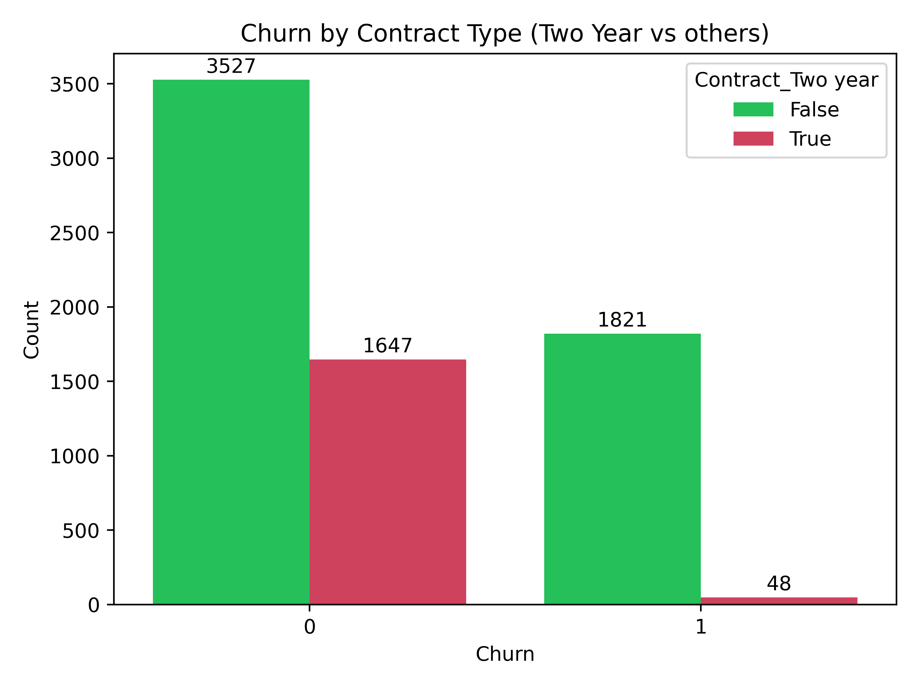
2. Churn by Contract Type
Key Insight: Contract length significantly impacts customer churn.
Observations:
Non-Two-Year Contracts (False):
A large number (3527) of customers on these contracts do not churn.
However, a very substantial number (1821) of customers on these contracts do churn. This group represents the vast majority of all churn.
Two-Year Contracts (True):
A good number (1647) of customers on two-year contracts do not churn.
Crucially, only a minimal number (48) of customers on two-year contracts do churn.
Conclusion: Customers on Two-Year contracts have a significantly lower propensity to churn compared to those on month-to-month or one-year contracts. Promoting longer-term contracts is a strong churn prevention strategy.

Slide 8
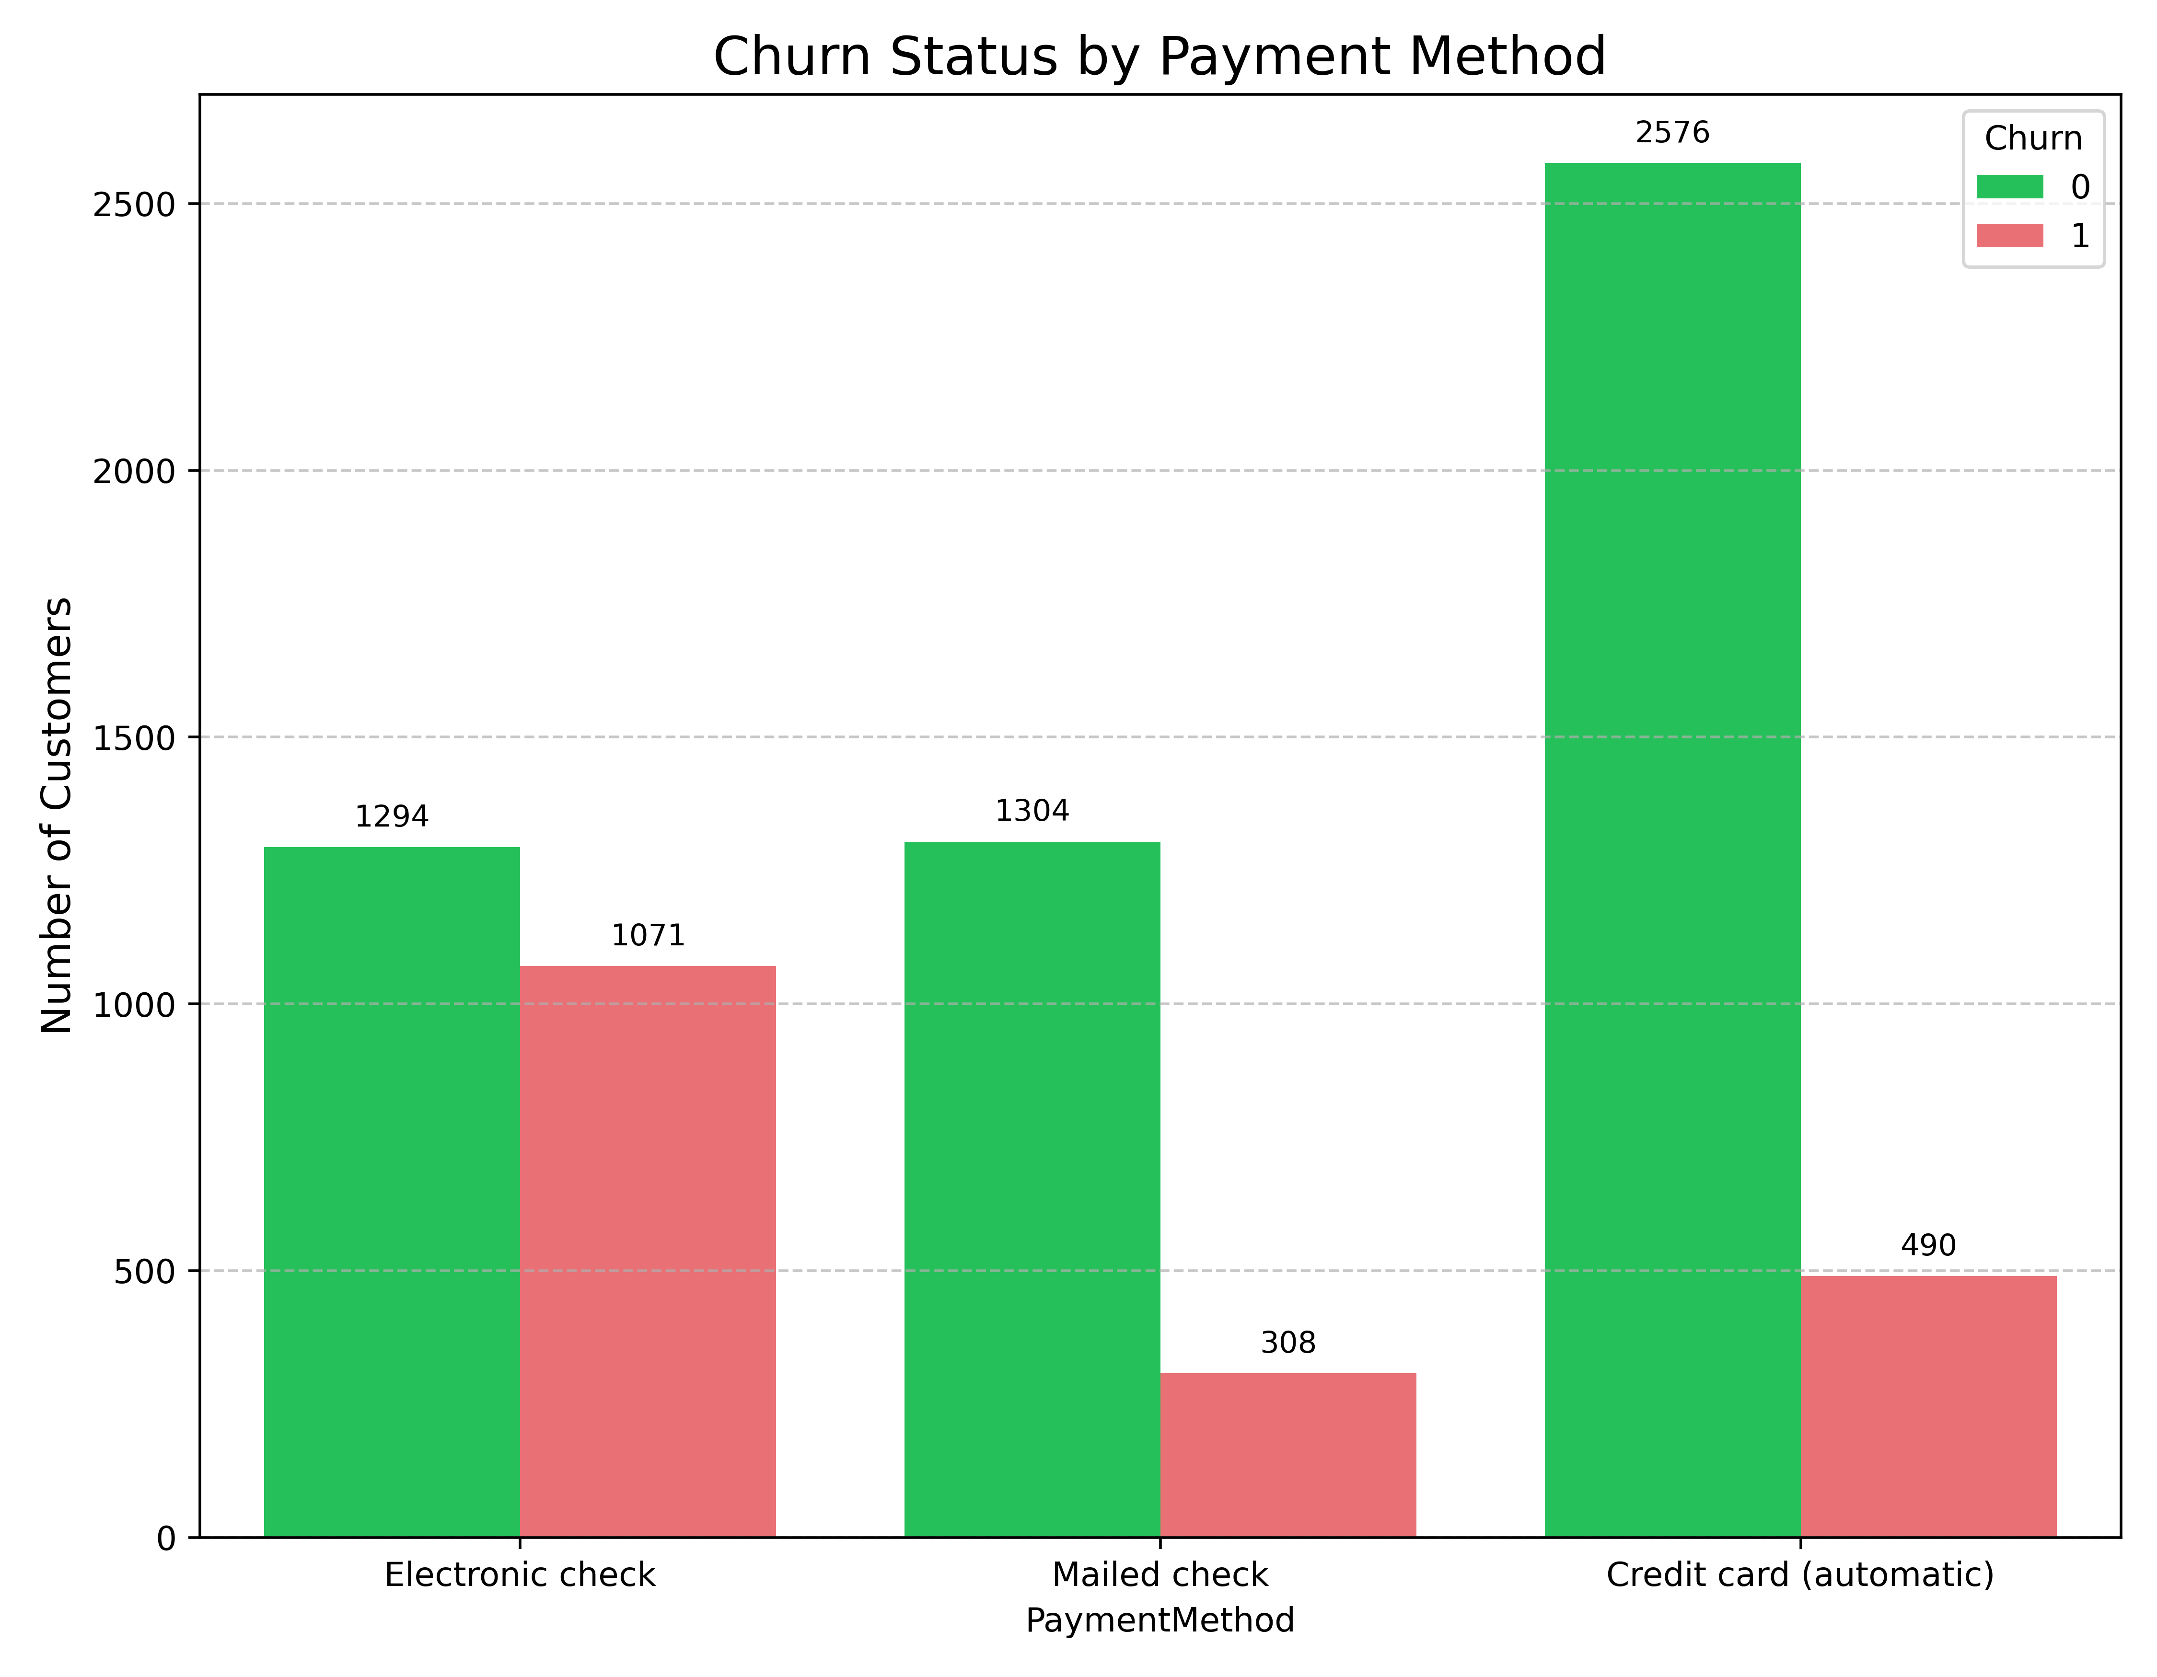
3. Churn Status by Payment Method
Key Insight: The choice of payment method is a strong indicator of churn risk.
Observations:
Electronic Check: This method shows the highest churn rate. The number of churned customers (1071) is very close to the non-churned customers (1294). This group is a major contributor to overall churn.
Mailed Check: Shows a moderate churn rate (308 churned vs. 1304 non-churned).
Credit Card (automatic): This method has the lowest proportional churn rate, with a large number of non-churned customers (2576) and relatively few churned customers (490).
Conclusion: Customers using Electronic Check are at a significantly higher risk of churning. Investigating issues related to this payment method or encouraging migration to automatic payment methods could reduce churn.

Slide 9
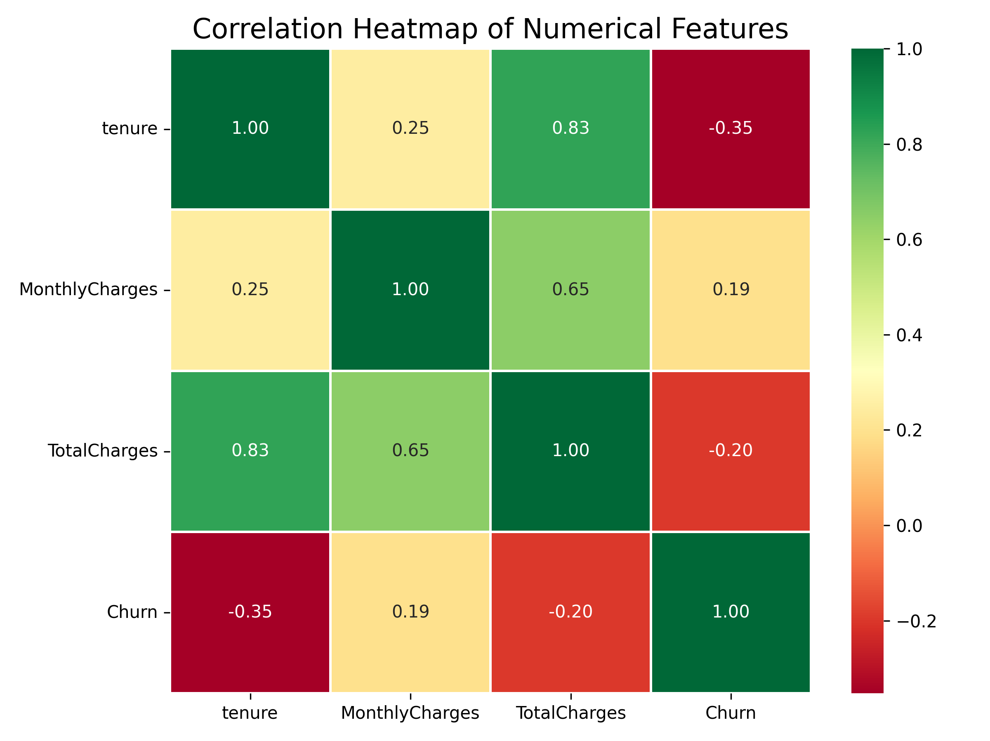
4. Numerical Feature Correlations
Key insight: Identifies relationships between numerical features and churn.
Observations:
Tenure vs. Churn (-0.35): moderate negative correlation. As tenure increases, churn decreases.
Monthlycharges vs. Churn (0.19): weak positive correlation. Slight tendency for higher monthly charges to correlate with churn.
Totalcharges vs. Churn (-0.20): weak negative correlation. Higher total charges (indicating longer customer lifespan) are associated with lower churn.
Tenure vs. Totalcharges (0.83): strong positive correlation, as expected.
Monthlycharges vs. Totalcharges (0.65): moderate positive correlation.
Implication: Tenure is a significant factor in churn prediction, with longer-term customers being more stable.

Slide 10
Feature Selection & MODEL TRAINING:
Importance: Feature selection is a crucial step in preparing data for machine learning. Its primary objectives include:
Improving Model Performance: By focusing on the most relevant variables, the model can learn more effectively and achieve higher predictive accuracy.
Reducing Overfitting: Eliminating irrelevant or redundant features helps the model generalize better to unseen data, preventing it from memorizing noise.
Decreasing Training Time: A reduced feature set leads to faster model training and more efficient resource utilization.
Enhancing Interpretability: Simpler models with fewer, highly impactful features are easier to understand and explain to stakeholders.

Slide 11
Random forest classifier:
Approach: While the specific feature selection method is not explicitly detailed in the provided step, it is understood that a rigorous process was undertaken to identify the most predictive features from the available dataset. This process ensures that only the most informative variables are passed to the machine learning model for training.
Common techniques for customer churn prediction might include:
Filter Methods: Using statistical measures (like correlation, chi-squared tests, or mutual information) to rank features independently of the model.
Wrapper Methods: Using a specific machine learning model to evaluate subsets of features (e.g., Recursive Feature Elimination).
Embedded Methods: Techniques where feature selection is built into the model training process itself (e.g., L1 regularization, or feature importance from tree-based models like Random Forest). Given that a Random Forest Classifier is subsequently used, its inherent ability to provide feature importance scores is a strong candidate for an embedded selection method.

Slide 12
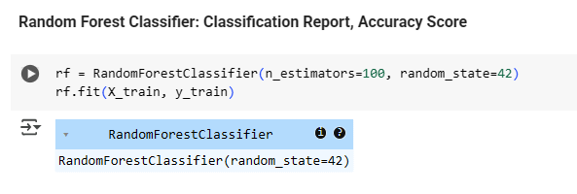
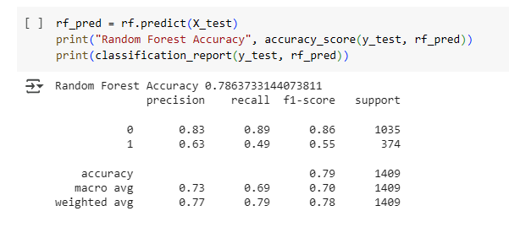
Classification Report, Accuracy Score
Outcome: The selected features form the input (X_train, X_test) for the subsequent model training and evaluation phase, aiming to provide the best possible data representation for accurate churn prediction.

Slide 13
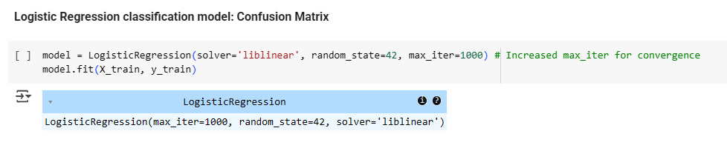
Logistic regression:
Logistic Regression (for Binary Classification):Logistic Regression is a related linear model specifically designed for binary classification problems. Instead of predicting a continuous value, it predicts the probability that an instance belongs to a certain class (e.g., the probability of a customer churning). This probability is then transformed into a binary outcome (churn/no churn).

Slide 14
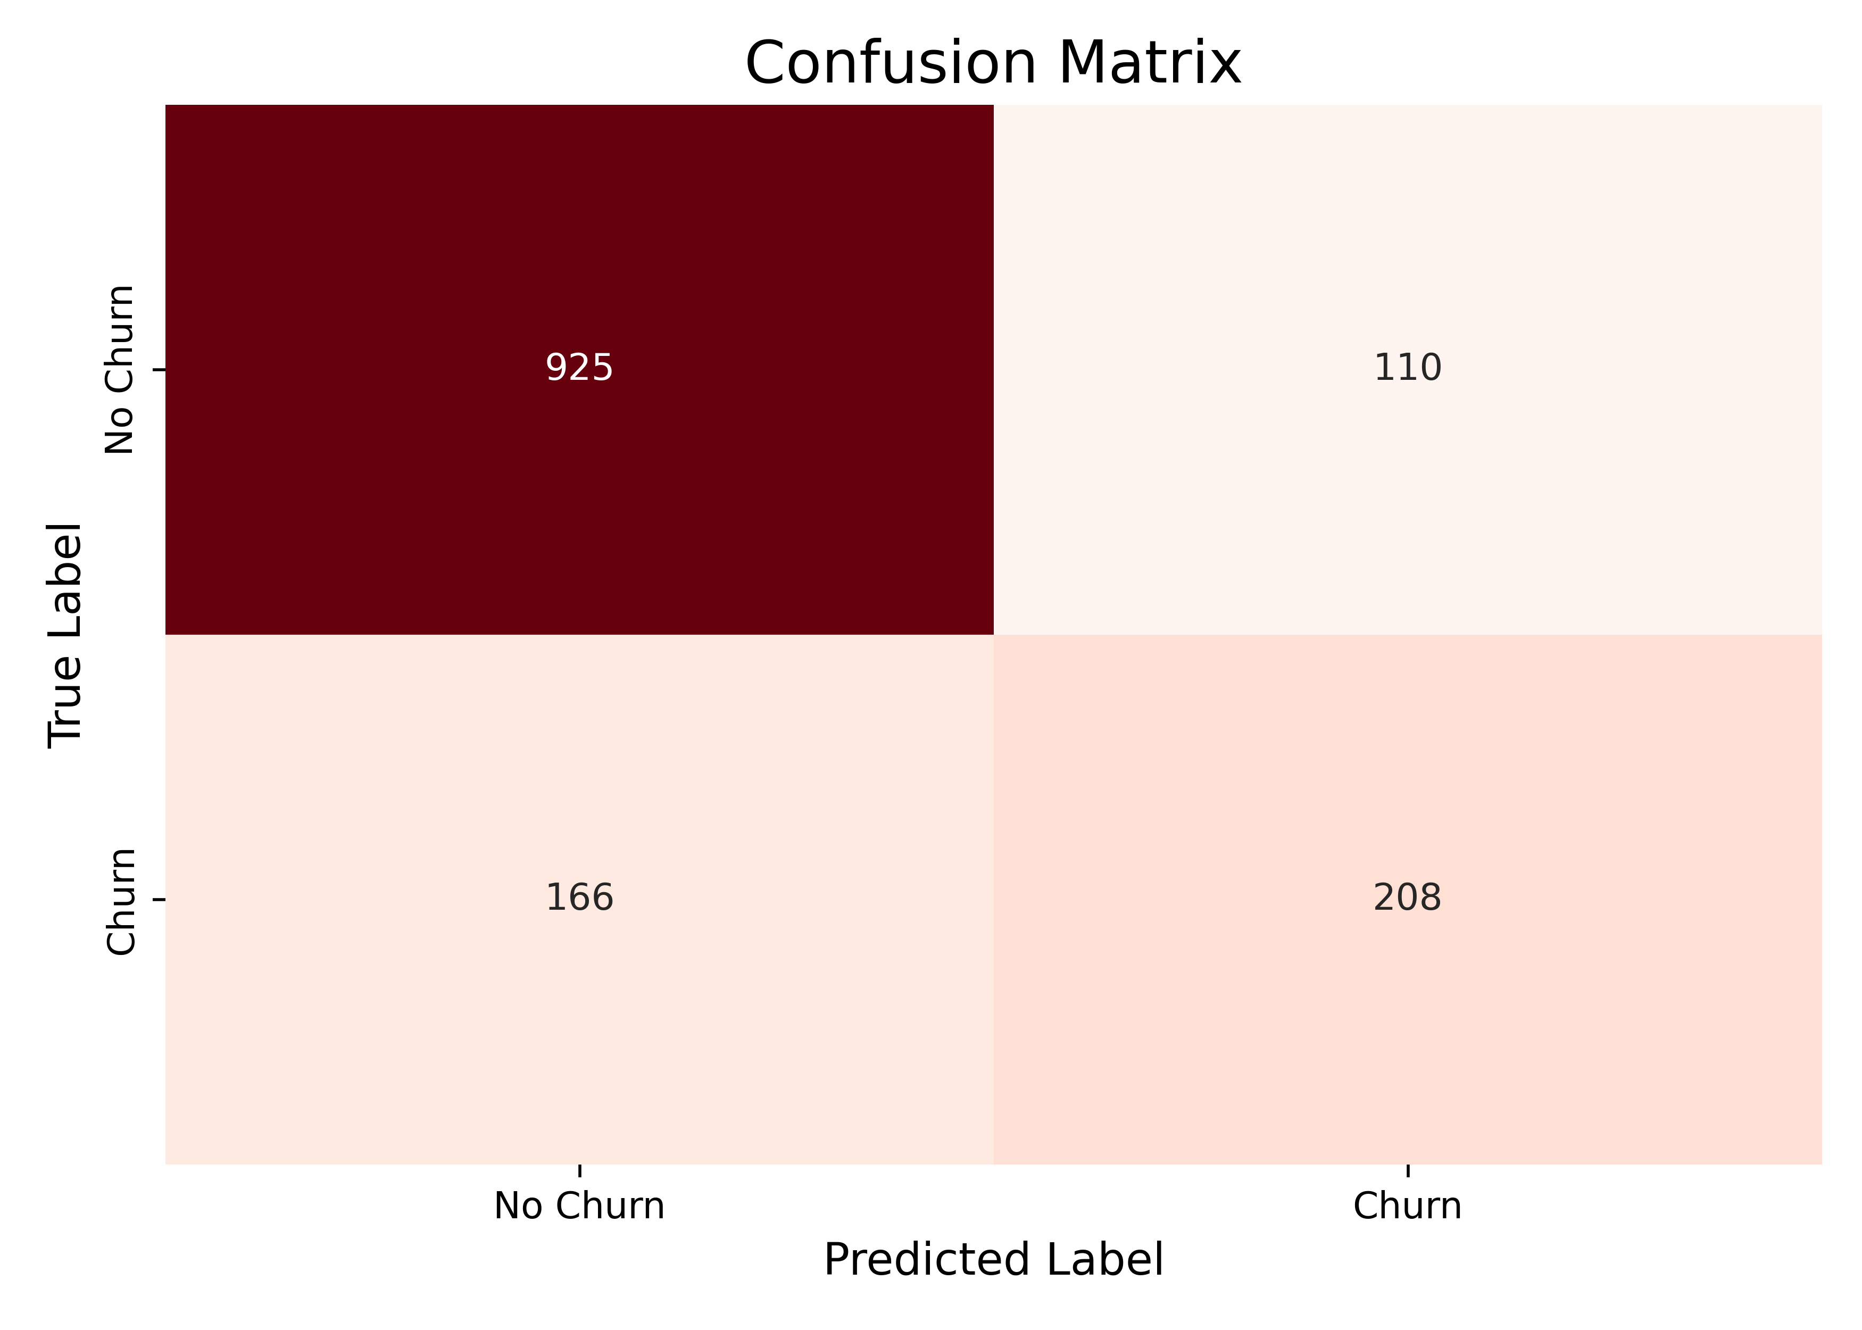
LOGISTIC REGRESSION: Confusion Matrix
Key insight: evaluates the accuracy of the churn prediction model.
Matrix breakdown:
True negatives (TN): 925: Correctly predicted "no churn" (customers who did not churn).
False positives (FP): 110: Incorrectly predicted "churn" (customers who did not churn but were flagged). Represents a type i error.
False negatives (FN): 166: Incorrectly predicted "no churn" (customers who churned but were missed). Represents a type ii error; often more costly as it means lost customers.
True positives (TP): 208: Correctly predicted "churn" (customers who actually churned).
Conclusion: the model has a decent number of correct predictions, but the 166 false negatives indicate a need for improvement in identifying actual churners.

Slide 15
Conclusion & Recommendations
Key Churn Drivers Identified:
Lower Tenure: Newer customers are more likely to churn.
Non-Two-Year Contracts: Flexible contracts (e.g., month-to-month) show much higher churn rates.
Electronic Check Payment Method: This payment method is strongly associated with churn.
Monthly Charges: Slightly higher monthly charges may contribute to churn.
Model Performance: The Random Forest model achieved ~79% accuracy, but recall for the churn class (49%) needs improvement.

Slide 16
Conclusion & Recommendations
Actionable Recommendations:
Target Early-Stage Customers: Implement robust onboarding programs and proactive outreach for new customers (especially those with low tenure) to ensure satisfaction and engagement.
Promote Longer Contracts: Actively encourage customers to sign up for or upgrade to Two-Year contracts through incentives or discounts. Highlight the benefits of stability.
Investigate Electronic Check Issues:
Analyse customer feedback specifically from those using electronic checks.
Consider offering incentives to switch to more stable payment methods like credit card automatic payments.
Ensure the electronic check payment process is seamless and free of friction.
Monitor Monthly Charges: Regularly review pricing structures and ensure customers understand the value they receive, especially if charges are perceived as high.
Refine Prediction Model: Focus on reducing False Negatives in the churn prediction model to better identify and intervene with at-risk customers before they churn.

Slide 17
Thank you
Paromita Saha
Intern Id: ITID0902
paromitasaha0720@gmail.com

